Slide 1
PowerPoint slides to accompany
System Dynamics, Third Edition
William J. Palm III
Using Simscape™ for Modeling Vibration Problems:
Dynamics of a Vehicle Suspension
Copyright © 2013. The McGraw-Hill Companies, Inc.

Slide 2
These slides are intended to be used with the author’s text, System Dynamics, 3/e, published by McGraw-Hill©2014.
Acknowledgments
The author wishes to acknowledge the support of McGraw-Hill for hosting these slides, and The MathWorks, Inc., who supplied the software. Naomi Fernandes, Dr. Gerald Brusher, and Steve Miller of MathWorks provided much assistance. Dr. Brusher’s contributions formed the basis for many of the Simscape models presented here.
MATLAB®, Simulink®, and Simscape™ are registered trademarks and trademarks of The MathWorks, Inc. and are used with permission.
The equations and math symbols in these slides were created with the new equation editor in PowerPoint 2010, and thus material containing these elements will appear as graphics when viewed in an earlier version.

Slide 3
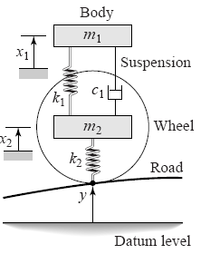
Simscape™ extends the capabilities of Simulink® by providing tools for modeling and simulation of multi-domain physical systems, such as those with mechanical, hydraulic, and electrical components. In this presentation, we will show you how to utilize Simscape to construct models of a vehicle suspension, whose representation is shown below. This is the so-called quarter-car model of a vehicle suspension, because it models only the body mass associated with one wheel.

Slide 4
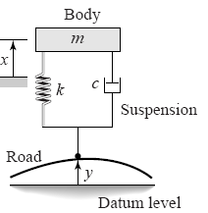
Example 1: A Single-Mass Model First we will start with a simple model, one containing a single mass. This representation is shown below. In this simplified model, the masses of the wheel, tire, and axle are neglected, and the mass m represents one-fourth of the vehicle mass. The spring constant k models the series combination of the elasticity of the tire and the suspension spring. The damping constant c models the shock absorber. The equilibrium position of m when y = 0 is x = 0. The road surface displacement y(t) can be derived from the road surface profile and the car’s speed. This is Example 4.5.8 in System Dynamics, 3/e.

Slide 5
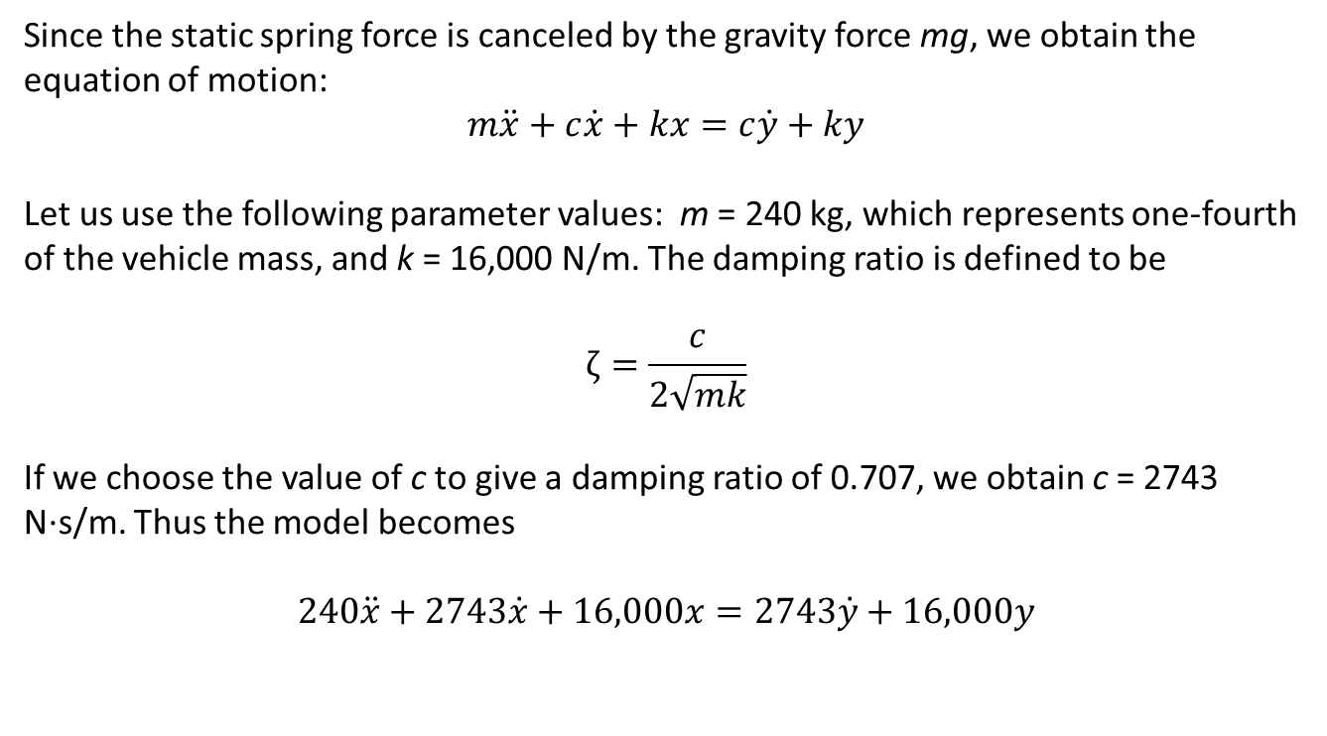
Since the static spring force is canceled by the gravity force mg, we obtain the equation of motion:
$$m\ddot{x}+c\dot{x}+kx=c\dot{y}+ky$$
Let us use the following parameter values: m = 240 kg, which represents one-fourth of the vehicle mass, and k = 16,000 N/m. The damping ratio is defined to be
$$ζ=\frac{c}{2\sqrt{mk}}$$
If we choose the value of c to give a damping ratio of 0.707, we obtain c = 2743 N·s/m. Thus the model becomes
$$240\ddot{x}+2743\dot{x}+16,000x=2743\dot{y}+16,000y$$

Slide 6
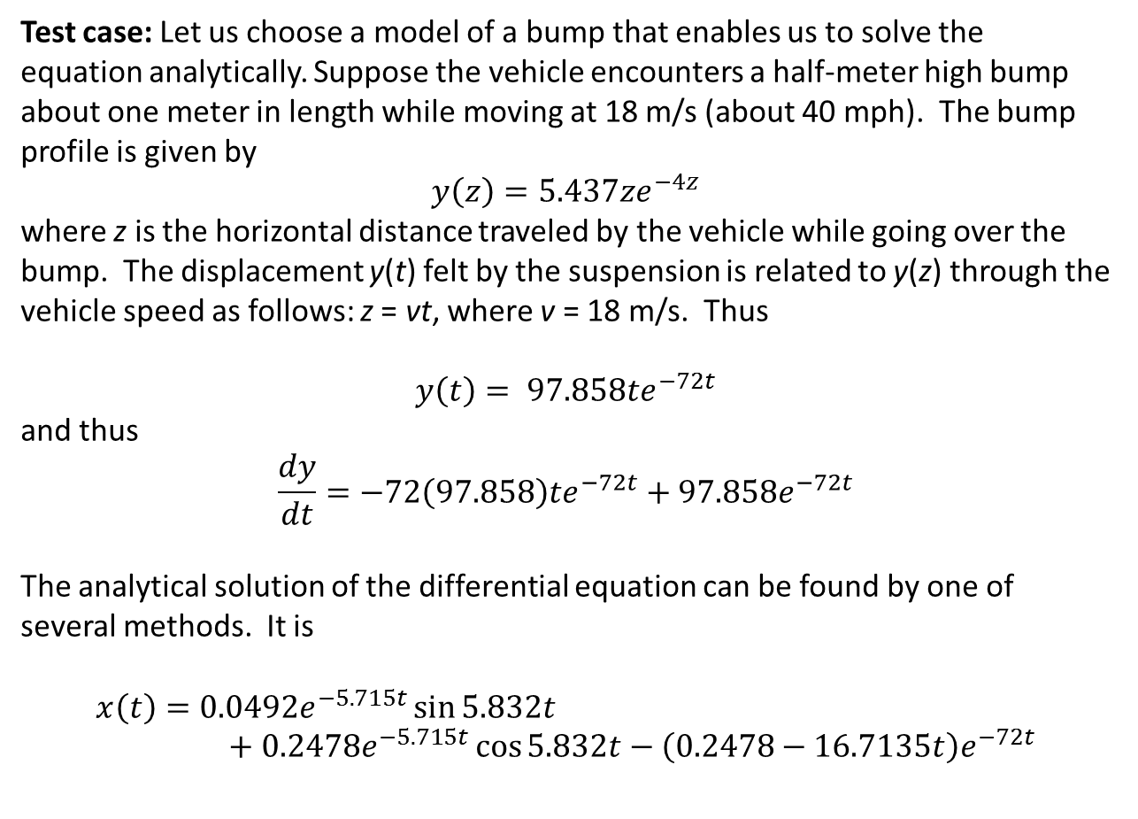
Test case: Let us choose a model of a bump that enables us to solve the equation analytically. Suppose the vehicle encounters a half-meter high bump about one meter in length while moving at 18 m/s (about 40 mph). The bump profile is given by
$$y\left(z\right)=5.437ze^{−4z}$$
where z is the horizontal distance traveled by the vehicle while going over the bump. The displacement y(t) felt by the suspension is related to y(z) through the vehicle speed as follows: z = vt, where v = 18 m/s. Thus
$$y\left(t\right)= 97.858te^{−72t}$$
and thus
$$\frac{dy}{dt}=−72\left(97.858\right)te^{−72t}+97.858e^{−72t}$$
The analytical solution of the differential equation can be found by one of several methods. It is
$$x\left(t\right)=0.0492e^{−5.715t}\sin{5.832t}+0.2478e^{−5.715t}\cos{5.832t−\left(0.2478−16.7135t\right)e^{−72t}}$$

Slide 7
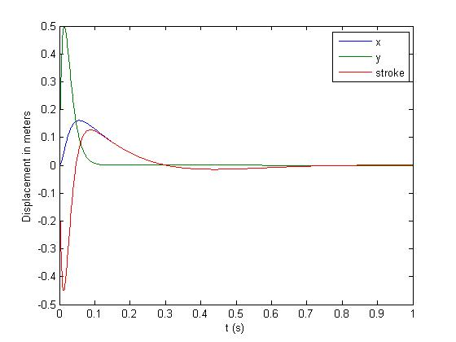
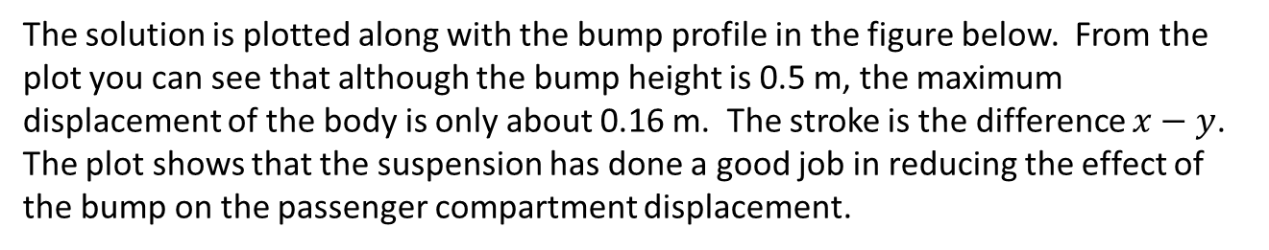
The solution is plotted along with the bump profile in the figure below. From the plot you can see that although the bump height is 0.5 m, the maximum displacement of the body is only about 0.16 m. The stroke is the difference $x−y$. The plot shows that the suspension has done a good job in reducing the effect of the bump on the passenger compartment displacement.

Slide 8
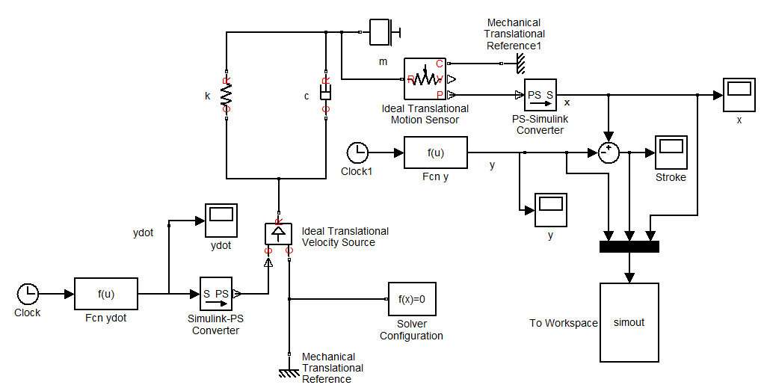
Now let’s construct a Simscape model. The final result is shown below. We will construct it step by step.

Slide 9
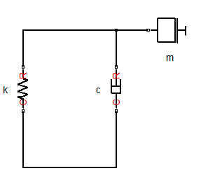
Let’s start with the model of the mass, spring, and damper. From the Simscape>Foundation Library>Mechanical>Translational Elements library, select and place the Mass, Translational Damper, and Translational Spring blocks. Connect them as shown.
Let’s look at the Block Parameters window for each of these elements.

Slide 10
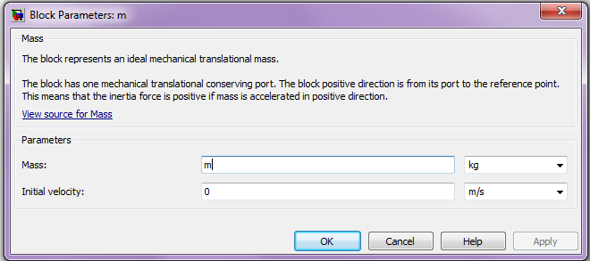
The definition of the Mass block is shown in the Block Parameters dialog box. It has two parameters: its mass value, whose units may be selected, and its initial velocity, also specified in selectable units.

Slide 11
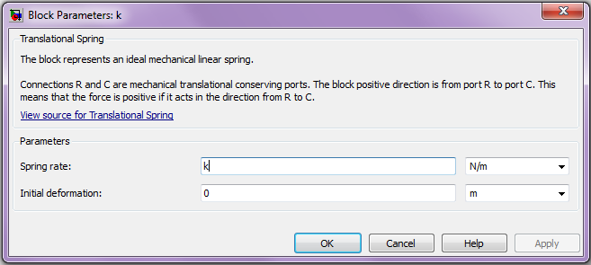
The definition of the Translational Spring block is shown in the Block Parameters dialog box. It has two parameters: its spring rate (also called its spring constant), and its initial deformation (which is positive if the spring is compressed). Because we are measuring x from the equilibrium position, and since the weight cancels the static spring force, we can take the initial deformation to be zero. The units for both parameters are selectable.
It is important to understand that Simscape is based on power flows. For a mechanical element, power is the product of force and velocity. Thus the ports of the translational spring element must be connected only to elements that store, dissipate, or transmit mechanical power.

Slide 12
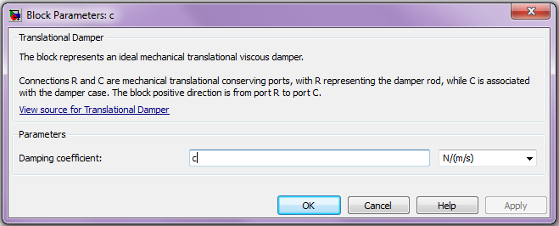
The definition of the Translational Damper block is shown in the Block Parameters dialog box. It has one parameter: its damping coefficient. The units are selectable.
As with the translational spring element, the R and C ports of the damper element must be connected only to elements that store, dissipate, or transmit mechanical power.

Slide 13
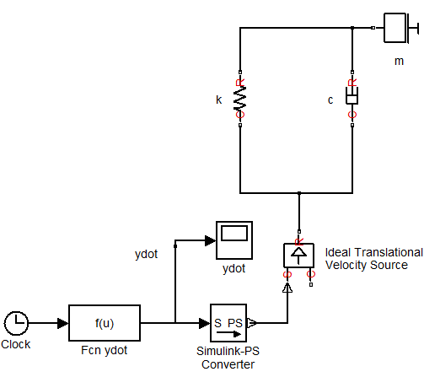
Thus we must apply a velocity input to the C ports of the spring and damper elements, even though our model has a displacement input, the road profile y(t). Thus we must differentiate y(t) before using it as an input. The derivative was given earlier and is programmed as
-72*97.858*u*exp(-72*u)+97.858*exp(-72*u)
in the Fcn ydot block shown to the right.
The Fcn ydot block is in the Simulink>User Defined Functions library. The remaining blocks are discussed on the next two slides.

Slide 14
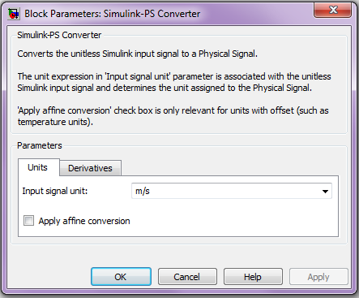
The Scope and Clock blocks are basic Simulink blocks in the Sinks and Sources libraries, respectively. Select and place them as shown.
Select and place the Simulink-PS Converter block from the Simscape>Utilities library. This block converts a Simulink signal to a physical signal (PS) . Its Block Parameters window is shown below. Here the units were selected to be m/s.

Slide 15
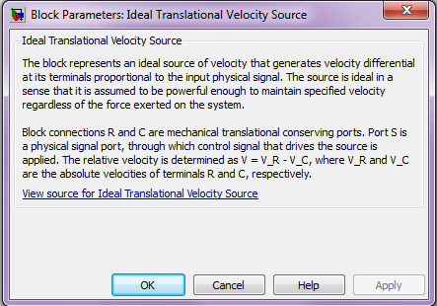
Next select and place the Ideal Translational Velocity Source block from the Simscape>Foundation Library>Mechanical> Mechanical Sources library. This element provides a velocity differential that is proportional to the input signal regardless of the force exerted on the system. The block has no parameters.

Slide 16
The model should now look like this.

Slide 17
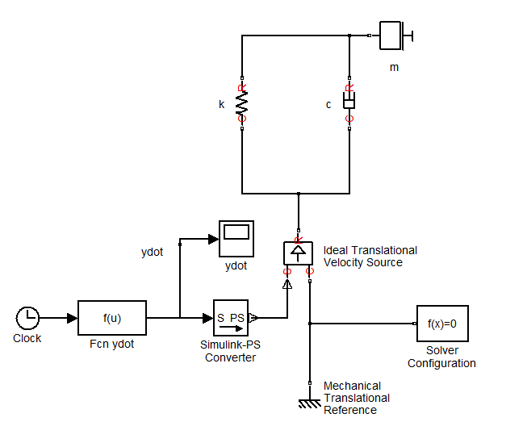
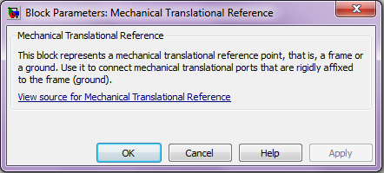
Now we will add two more blocks: The Solver Configuration block from the Simscape>Utilities library and the Mechanical Translational Reference block from the Simscape>Foundation Library>Mechanical>Translational Elements library. The latter provides a reference point for specifying velocity. Its Block Parameters window is shown below. It has no parameters. Connect it as shown.

Slide 18
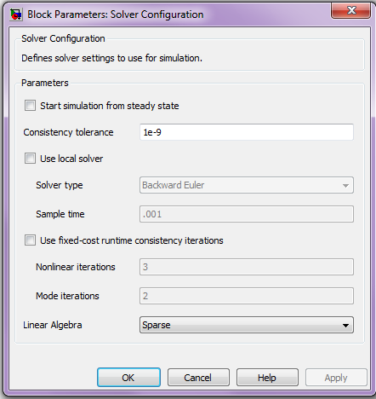
The Solver Configuration block defines the solver settings for this Simscape physical network. The Simulink solver for the entire model must be set separately. Its Block Parameters window is shown below. For this example, do not change any of the parameters in this block (all three boxes should be unchecked). Connect it as shown in the figure.

Slide 19
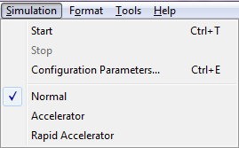
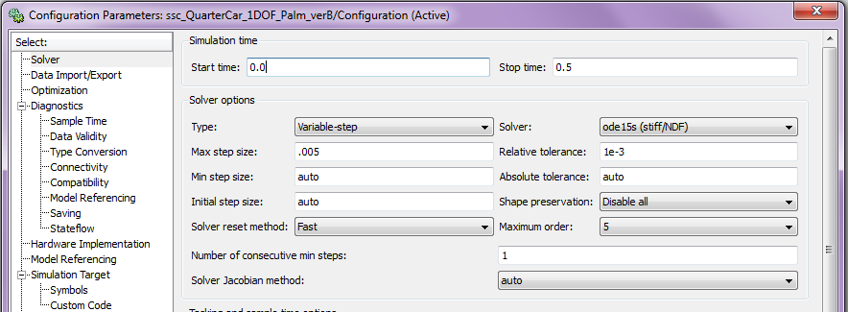
A Note About Solvers: The default solver is ode 45. It is strongly recommended that you change the solver to a stiff solver (ode15s, ode23t, or ode14x). Do this by selecting “Configuration Parameters” from the Simulation menu, selecting the solver pane from the list on the left, and changing the “Solver” parameter to ode15s. Then click OK.

Slide 20
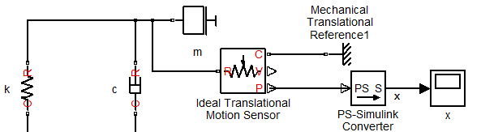
We will now add four more blocks as shown in the partial diagram below. Place the Ideal Translational Motion Sensor block, which is in the Simscape>Foundation Library>Mechanical>Mechanical Sensors library. Connect its R port to the Mass block. The next slide discusses this block.
Then select and place the PS-Simulink Converter block in the Simscape>Utilities library. This block converts the input physical signal (PS) to a unit-less Simulink output signal. Connect its input to the lower output port (P) of the motion sensor. This port provides a measurement of the position. The V port gives the velocity. Then connect the Scope as shown, and connect a Mechanical Translational Reference block to the C port of the motion sensor.

Slide 21
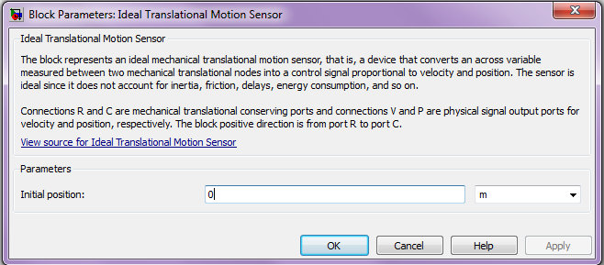
The Block Parameters window of the Ideal Translational Motion Sensor block is shown below. It has one parameter, the Initial position, whose units are selectable.

Slide 22
We are now ready to finish the model. Select and place another Clock and User Defined Function block as shown. The code entered in the Fcn y block is shown on the next slide. Then place the remaining two Scopes, the Mux, and the To Workspace block as shown. This completes the model.

Slide 23
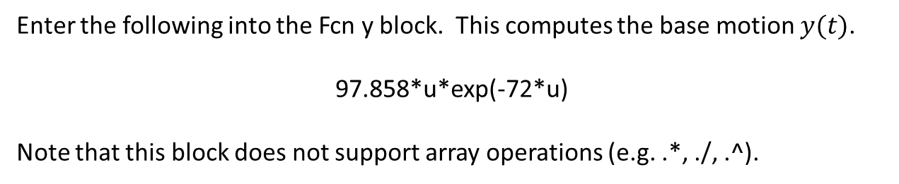
Enter the following into the Fcn y block. This computes the base motion $y(t)$.
97.858*u*exp(-72*u)
Note that this block does not support array operations (e.g. .*, ./, .^).

Slide 24
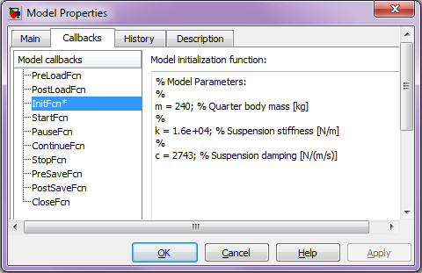
To store the values in the model file, you can create a script by selecting Model Properties/Callbacks/InitFcn from the File menu of the model window. You then type in the MATLAB® commands shown in the window below. This script could also be created in the MATLAB editor and pasted into the InitFcn window. Note that you can use it to perform calculations, although this feature is not needed here.

Slide 25
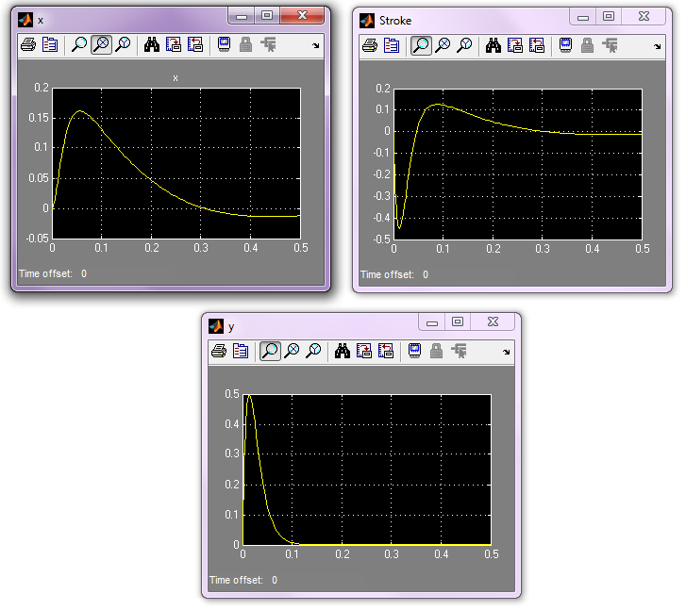
Now set the Stop Time to 0.5 s and run the model. The x, y, and Stroke Scopes should look like the following. These plots agree with the plot of the analytical solution displayed earlier. Thus our Simscape model is working correctly.

Slide 26
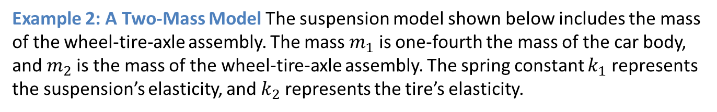
Example 2: A Two-Mass Model The suspension model shown below includes the mass of the wheel-tire-axle assembly. The mass $m_{1}$ is one-fourth the mass of the car body, and $m_{2}$is the mass of the wheel-tire-axle assembly. The spring constant $k_{1}$ represents the suspension’s elasticity, and $k_{2}$represents the tire’s elasticity.

Slide 27
The Simscape model is shown on the next slide. It requires no elements that we have not already discussed. Note that the two springs are connected in series (end-to-end), just as they are in the physical system. The two User Defined Function blocks are programmed just as in Example 1. The InitFcn commands are shown below.
% Model Parameters:
%
m1 = 240; % Quarter body mass [kg]
%
m2 = 36; % Suspension mass [kg]
%
k1 = 1.6e+04; % Suspension stiffness [N/m]
%
k2 = 1.6e+05; % Tire stiffness [N/m]
%
c1 = 2743; % Suspension damping [N/(m/s)]

Slide 28
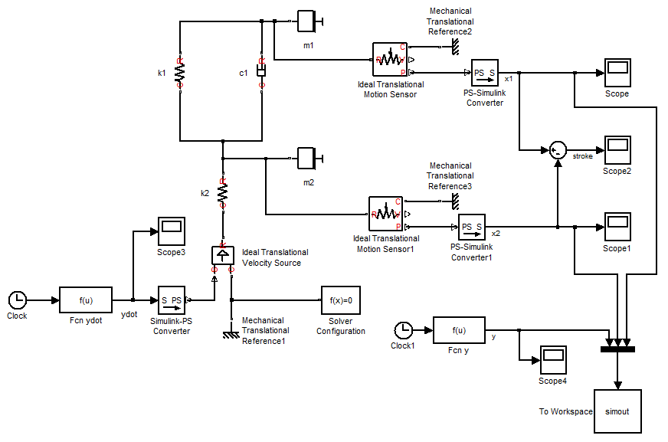

Slide 29
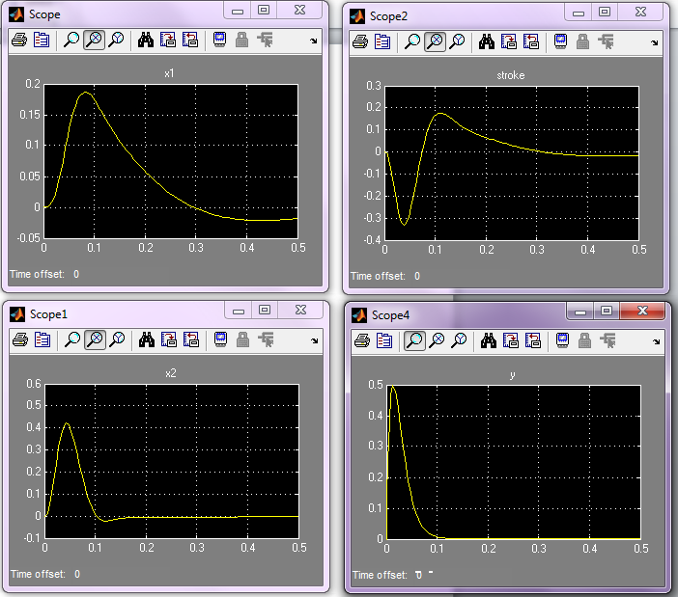
Set the Stop Time to 0.5 s and run the model. You should see the Scope displays shown below. The maximum body displacement is close to that of the 1-DOF model. This shows the value of using a simpler analytical model initially to estimate the required value of the damping coefficient c.

Slide 30
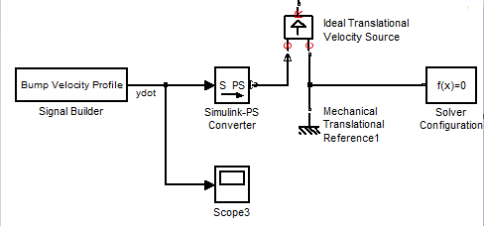
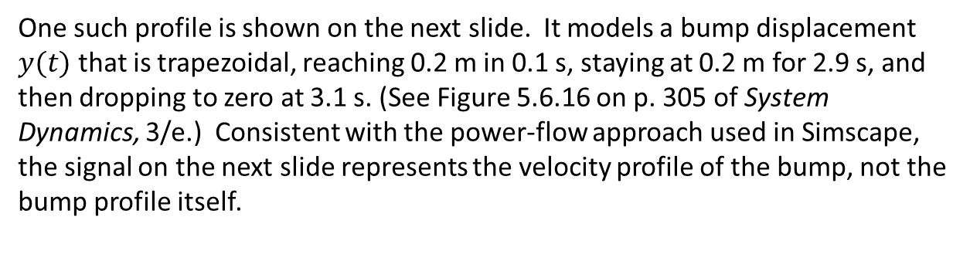
In closing we note that a bump model can also be described with a Signal Builder block. A relevant portion of the model is shown below. This approach is easier for a bump velocity profile that is not describable with a single function.
One such profile is shown on the next slide. It models a bump displacement $y(t)$ that is trapezoidal, reaching 0.2 m in 0.1 s, staying at 0.2 m for 2.9 s, and then dropping to zero at 3.1 s. (See Figure 5.6.16 on p. 305 of System Dynamics, 3/e.) Consistent with the power-flow approach used in Simscape, the signal on the next slide represents the velocity profile of the bump, not the bump profile itself.

Slide 31
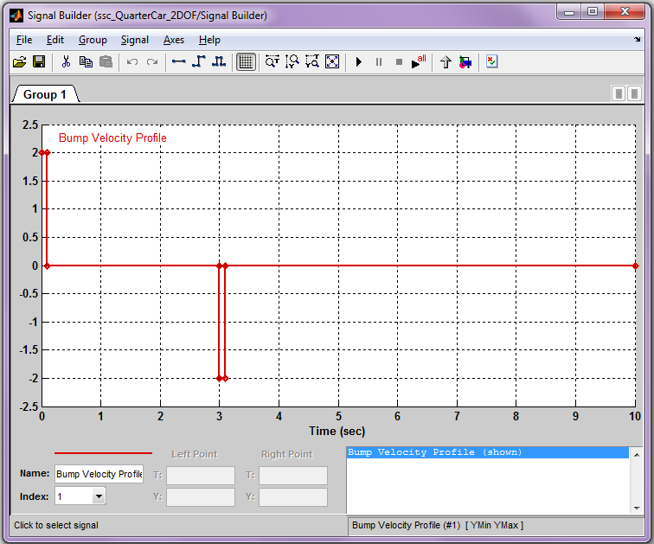
Set the Stop Time to 5 s. You should see the following in the Scopes. This concludes our presentation on solving vibration problems with Simscape.

Slide 32
